Slide 1
WP4 UC1 Workflow
Leader: ENG
LEAs: AoC, NPN, KWPG, GDCOC, LPV
GA Meeting
Thessaloniki, 23-24 January 2019

Slide 2
Outline
Scenario description
Operational needs
Proposed workflow

Slide 3
Scenario description (from D4.1)
Main crimes
a simple fraud mainly aimed at stealing bank details or obtaining profits (without delivering any product – non supply)
Falsified medicines usually are disguised as authentic medicines, but may contain ingredients of bad or toxic quality, or in the wrong dosage
legal access to certain products varies from country to country
Emerging ‘fake online pharmacies’

Slide 4
Operational needs (from D4.1)
The objectives of police are focused on tracing all crypto-currency transactions that have illegal behaviour, in order to find helpful information about other suspects that are connected with the case. In particular, the police try to discover the real individuals behind the Dark Nets, as well as discovering new transactions in the predefined structures that have been detected. More specifically, the police should be able to detect the owners from the Dark Web sites that sell ‘opioids’, the owners of the enterprises that trade NPS and drugs on the edge of the law, and to detect individuals that make trade of medicines and pills relevant to sexual performance. To address this, links among persons should be identified, while the level of interaction among them should be identified. In this respect, ANITA could provide a set of ontologies to model all crime aspects, including events, suspicious and illegal activities, threats, persons and organisations. Additionally, indexing of large-scale information that has been collected form Dark and Shallow Web is necessary. Specifically, the processes of detecting and analysing Web pages and advertisements placed on the shallow web could be improved. ANITA should be able to provide tools for fast retrieval of relevant visual content, such as detection of fake advertisements in large scale databases. Additionally, tools for detecting wallet addresses that are hidden from large-scale visual content would useful. Moreover, the identification of other persons or organisations, which are relevant to a specific case, is a big challenge. To address this, searching for similar visual and textual content that has been uploaded on social media accounts, emails and personal sites is critical. ANITA should provide crawlers that are able to acquire content from sources, such as social networks (twitter, Facebook). These crawlers will have to detect heterogeneous resources and specific taxonomies will need to be defined for content pre-processing. The crawled data (texts, social media profiles and emails) will lead to large scale online databases, where procedures such as similarity search and object detection will be required.

Slide 5
Operational needs (from D4.1)
Trace all crypto-currency transactions that have illegal behaviour, in order to find helpful information about other suspects that are connected with the case;
Discover the real individuals behind the Dark Nets, as well as discovering new transactions in the predefined structures that have been detected.
owners from the Dark Web sites;
owners of the enterprises that trade NPS and drugs on the edge of the law;
individuals that make trade of medicines and pills;
links among persons and the level of interaction among them.
Index large-scale information that has been collected form Dark and Shallow Web
Detect and analyse Web pages and fake advertisements on the surface web;
Detect wallet addresses that are hidden from large-scale visual content;
Acquire content from sources through crawlers and perform similarity search
Textual and multimedia files shared in social media;
Emails;
Personal website

Slide 6
Scenario description (from D4.1)
Strategies
‘follow the money’ approach, aimed at tracking both on the Dark Web and on surface e-payments, crypto-currency transactions etc.
linking the detected transactions with social media profiles or other online intelligence sources

Slide 7
Scenario description (from D4.1)
The following sub-cases refer to the way that the drugs and NPS trade works, nowadays. The police need to know not only the individuals (seller and buyers) that are involved in the drug and NPS trafficking but also the strategies that the sellers follow in order to deliver their product to buyers.

Slide 8
Scenario description (from D4.1)
Jane bought drugs from a Dark market
Jane was browsing the internet and looking to buy drugs from a Dark Net marketplace. Access to such markets can be achieved in a number of ways. She was looking for a surface website that provided listings of ‘onion’ addresses for Dark Net markets, thus enabling ready access. She accessed one of the markets through an invitation (this is the only way possible to enter that market). While browsing for the drugs she was looking for (opioids), she found that each of the websites had its own method of classifying what it had on sale. Utilising anonymization services to browse the web without revealing her identity or location, Jane used ‘GRAMS’ as one of the search engines for Tor-based Dark Net markets. She entered the market and registered with an email janedoe@jane.com. The nickname that she used was ‘DoeJane’. She found the section in the marketplace marked as ‘opioids’ and established contact with the trader. The trader’s nickname was ‘Smithsopioids’. They started to communicate using secure applications, which removed the risk of such communications being intercepted. The messages between the seller and the buyer were encrypted using a cryptographic system, such as public key encryption. The payment was made again through anonymous transactions. Jane sent the money through a crypto-wallet and the virtual currency was Monero. As agreed with the seller, she received the drugs one week after she had completed the transaction. The police has not yet arrested the market owner, due to the lack of evidence (e.g. tracing of crypto-currency transactions). The evidence, such as money trails, could lead to the discovery of the fraud network.

Slide 9
Scenario description (from D4.1)
Jane bought drugs from a Dark market
Workflow must follow what LEAs would do starting from initial available forensic data, in order to reconstruct the chronological order of events and the links among involved individuals/organizations.
This implies that the starting point of ANITA wokflow(s) is the analysis of available data (officer knowledge, seized items, testimonies, emails, online contents) in order to reconstruct the knowledge graph.
Based on retrieved data, additional analyses and reasoning mechanisms can be applied to discover new knowledge (e.g. by tracking black markets evolution and illegal trafficking activities).

Slide 10
Available forensic data for investigation (from D4.1)
Jane bought drugs from a Dark market
E-mails of users which buy NPS and drugs from Dark Nets such as (janedoe@jane.com)
Known marketplaces of Dark Nets that sell drugs and NPS
The browsing history of the buyer’s computer that has been seized
Nicknames of the buyer and seller (“Smithsopioids”, “DoeJane”)

Slide 11

Workflow
Jane bought drugs from a Dark market
www.publicwebsite.com
Content acquisition from Surface Web and pre-processing (T5.3)
Source
Multilingual automated translation (T6.3)
Multilingual Text analysis (T6.1)
URL
www.publicwebsite.com
Data source risk assessment (T5.1)
Resource analysis
Source
URL
Image analysis (T6.2)
***b3r6espa33w.onion/

Slide 12
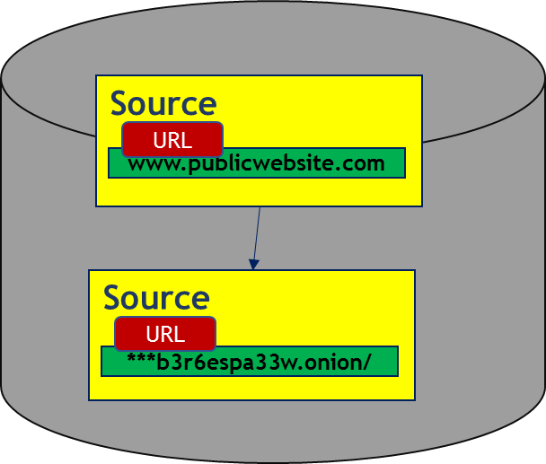
Workflow
Jane bought drugs from a Dark market
Black markets and illegal shops and products tracking (T7.2)
***b3r6espa33w.onion/
Source
URL
***b3r6espa33w.onion/
Black markets discovery and monitoring (T5.2)
Multilingual automated translation (T6.3)
Multilingual Text analysis (T6.1)
Account
Product
Opioids
Alias
Product
Smithsopioids
Data source risk assessment (T5.1)
Resource analysis
PGP key
Cocaine
Bnfbnofn…
Email
Product
Image analysis (T6.2)
smiths@opioids
Ecstasy

Slide 13

Workflow
Jane bought drugs from a Dark market
Nickname ‘Smithsopioids’
Knowledge based browsing, search and retrieval (T7.4)
Account
Smithsopioids
PGP key
smiths@opioids
Graph
from
black
markets
Smithsopioids
Account
Product
Nickname
PGP key
Email address
Product
Account
Product
Nickname
PGP key
Product
Email address

Slide 14


Workflow
Jane bought drugs from a Dark market
Crypto wallet
Crypto address
Crypto address
325u3092
25u3209u32
same address
DoeJane
Blockchain analysis (T5.4)
Transaction
from
25u3209u32
.
.
.
to
vreber2321
Transaction
Person
Alias
Person
DoeJane
Crypto address
Transaction
Crypto address
25u3209u32
.
.
.
vreber2321
Crypto address
325u3092
Transaction

Slide 15
Workflow
Jane bought drugs from a Dark market
Sender: janedoe@jane.com.
Multilingual automated
translation (T6.3)
Multilingual Text analysis (T6.1)
Email message
Email content (Text)
DoeJane
Recipient: smiths@opioids
… and other information extracted by
Text analysis module
Person
Alias
Person
DoeJane
Email message
Email
Email
Category
smiths@opioids
janedoe@jane.com
Drug dealing

Slide 16
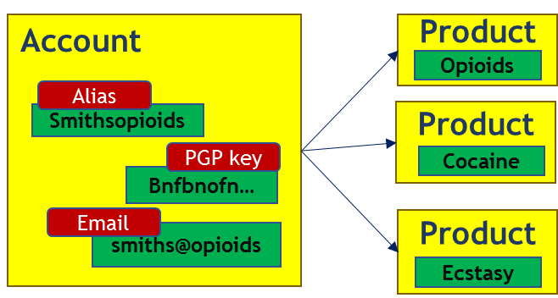
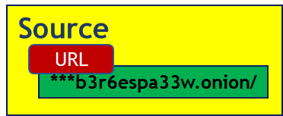
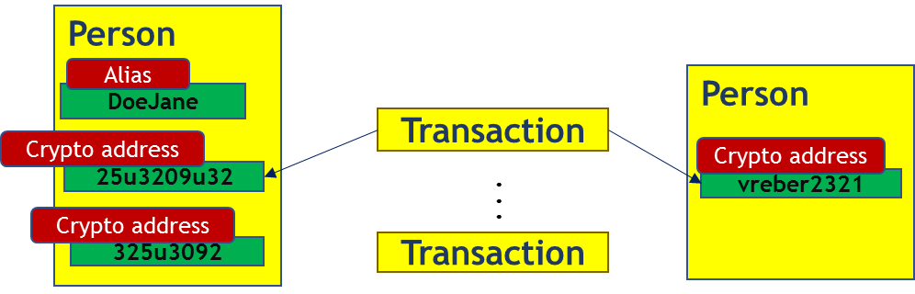
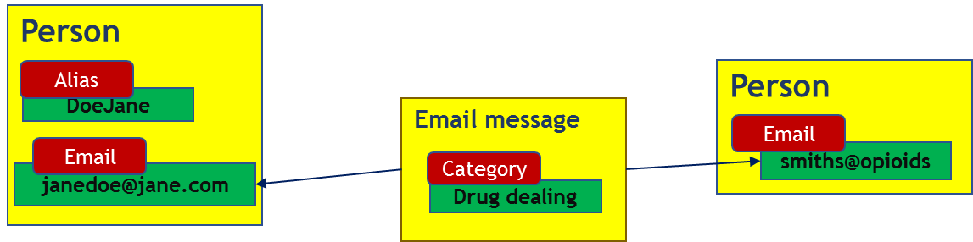
Workflow
Jane bought drugs from a Dark market
Criminal network reconstruction (T7.3)

Slide 17
Workflow
Jane bought drugs from a Dark market
Criminal network reconstruction (T7.3)

Slide 18
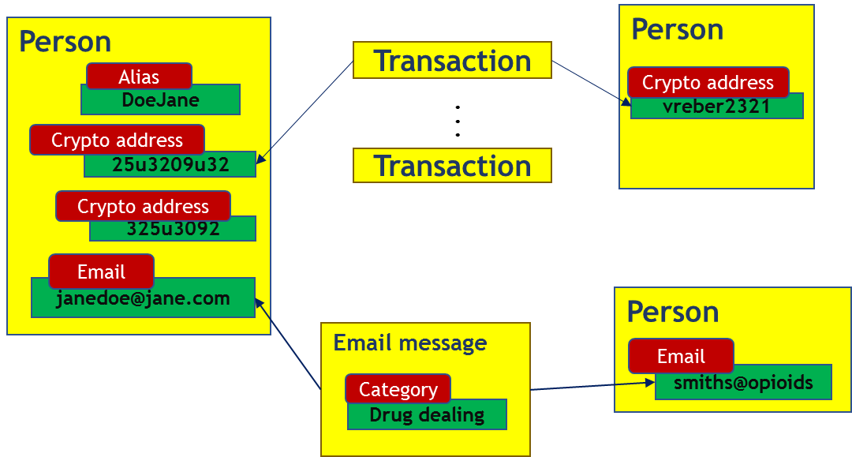
Workflow
Jane bought drugs from a Dark market
Criminal network reconstruction (T7.3)

Slide 19
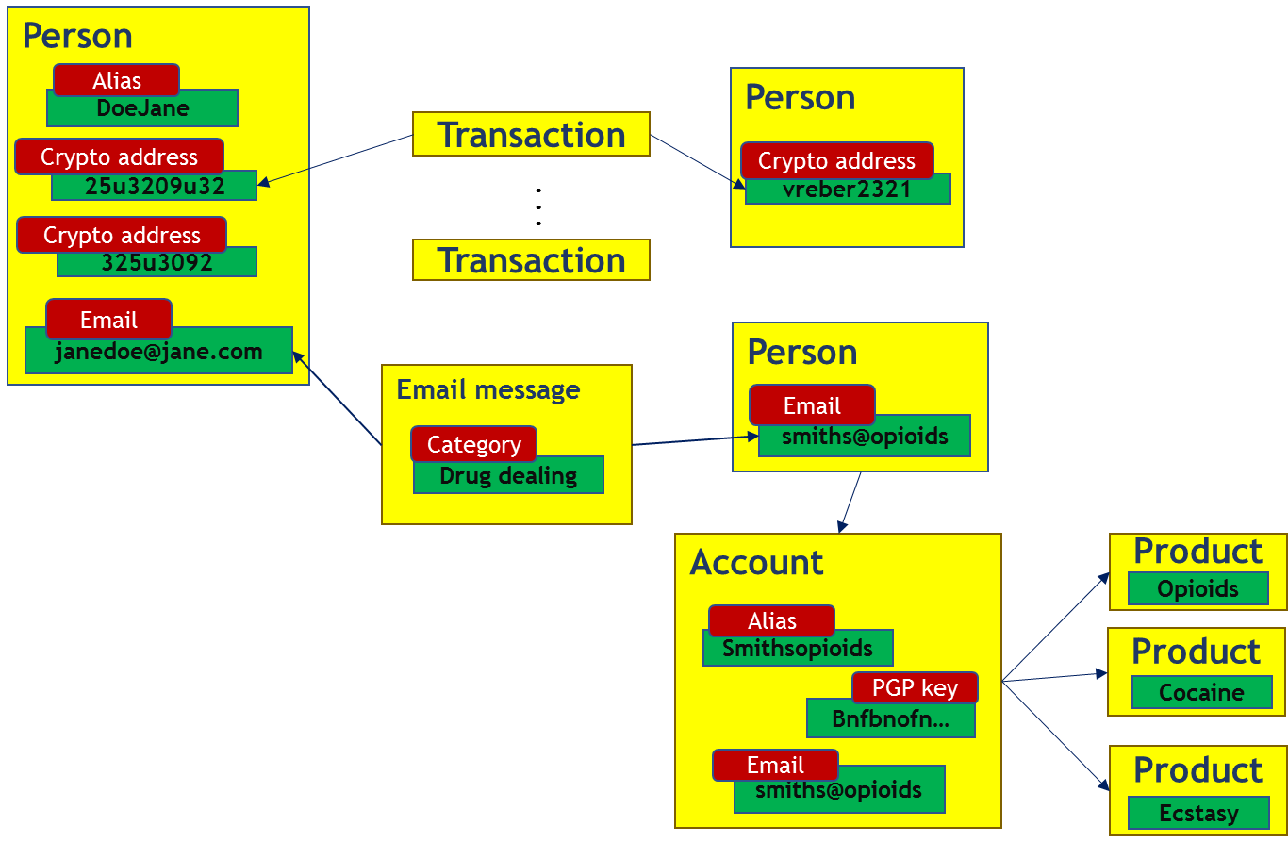
Workflow
Jane bought drugs from a Dark market
Criminal network reconstruction (T7.3)

Slide 20
Workflow
Jane bought drugs from a Dark market
Black markets and illegal shops and products tracking (T7.2)
Tracking of illegal markets and products can be executed continuously in order to alert users when new markets and/or products are found

Slide 21
Workflow
Jane bought drugs from a Dark market
Person
Alias
Person
DoeJane
Transaction
Crypto address
Crypto address
25u3209u32
.
.
.
vreber2321
Crypto address
Transaction
325u3092
Email
janedoe@jane.com
Person
Email message
Email
Category
smiths@opioids
Drug dealing
Account
Product
Opioids
Source
Alias
Product
Smithsopioids
URL
PGP key
Cocaine
***b3r6espa33w.onion/
Bnfbnofn…
Email
Product
smiths@opioids
Ecstasy

Slide 22
Workflow – System perspective
Jane bought drugs from a Dark market
Black markets discovery and monitoring (T5.2)
***b3r6espa33w.onion/
Chain of custody (T9.4)
Black markets and illegal shops and products tracking (T7.2)
Content acquisition from Surface Web (T5.3)
Data source risk assessment (T5.1)
Multilingual automated translation (T6.3)
Construction of source network and filtering (T5.5)
Multilingual Text analysis (T6.1)
www.publicwebsite.com
Resource analysis
Criminal network reconstruction (T7.3)
Email
Image analysis (T6.2)
Illegal trafficking trend analysis (T6.5)
Blockchain analysis for illicit activity discovering (T5.4)
25u3209u32

Slide 23
Workflow – System perspective
Jane bought drugs from a Dark market
Black markets discovery and monitoring (T5.2)
Chain of custody (T9.4)
Black markets and illegal shops and products tracking (T7.2)
Content acquisition from Surface Web and pre-processing (T5.3)
Data source risk assessment (T5.1)
Multilingual automated translation (T6.3)
Construction of source network and filtering (T5.5)
Multilingual Text analysis (T6.1)
Resource analysis
Criminal network reconstruction (T7.3)
Image analysis (T6.2)
Illegal trafficking trend analysis (T6.5)
Blockchain analysis for illicit activity discovering (T5.4)

Slide 24
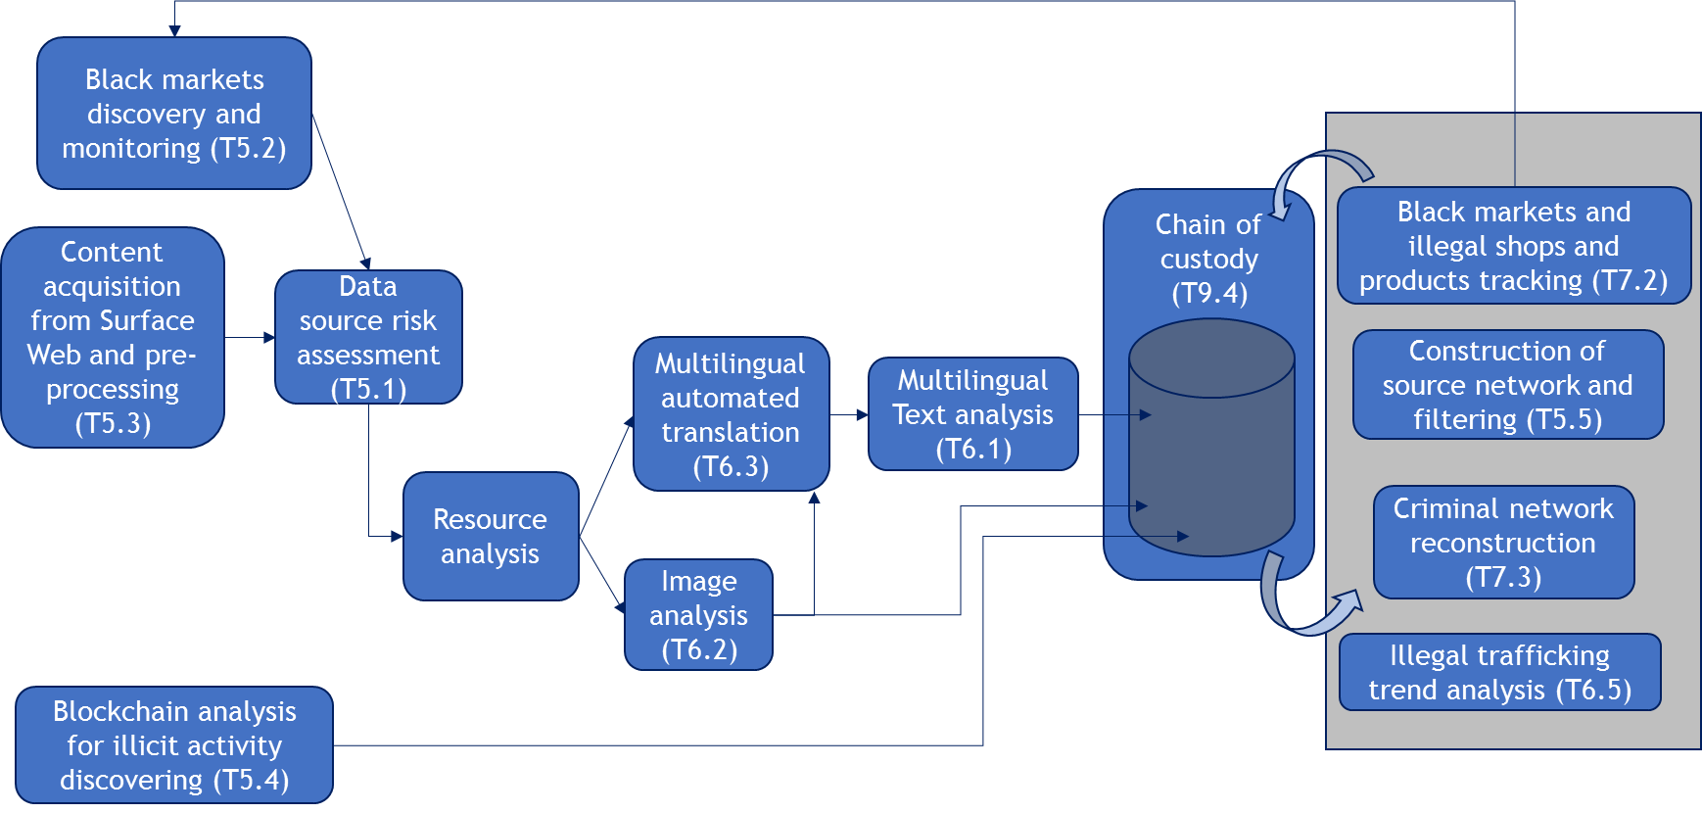
Workflow – Operational perspective
Evidence import
Novel applications (T9.2)
Source monitoring and data gathering
Knowledge browsing, search and retrieval (T7.4)
Evidence export (T9.4)
Advanced Big Data Visual Analytics (T9.4)

Slide 25
Scenario description (from D4.1)
Semi-legal business that sells NPS
A similar way to buy drugs has been observed in Poland. Some individuals who wanted to make a profit from the NPS and drug trafficking built an enterprise that works on the edge of the law. Specifically, they were selling an incredible amount of NPS substances, they had fully operational internet sites, accountants, coworkers and they were investing the earned money into their semi-legal business. More specifically, an individual has developed an Internet site named www.odczynnikichemiczne.net.pl in order to sell NPS. He is selling in various quantities that ranged from one gram to even a tonne to one buyer. The NPS is imported from China, Middle East, Balkans and other countries, and the payments were made using cash, money transfers, money orders, crypto-currency and foreign currencies. His profits were counted in millions of PLNPolish Zloty and he had several methods of money laundering and several dozen co-workers each with a large number of customers.

Slide 26
Scenario description (from D4.1)
Semi-legal business that sells NPS
Image analysis (T6.2)
www.odczynnikichemiczne.net.pl
Resource analysis
Multilingual automated translation (T6.3)
Multilingual Text analysis (T6.1)
Content acquisition from Surface Web and pre-processing (T5.3)
Data source risk assessment (T5.1)
Risky source?
Person
Source
Crypto-address
URL
www.odczynnikichemiczne.net.pl
vreber2321
Email
smiths@opioids

Slide 27
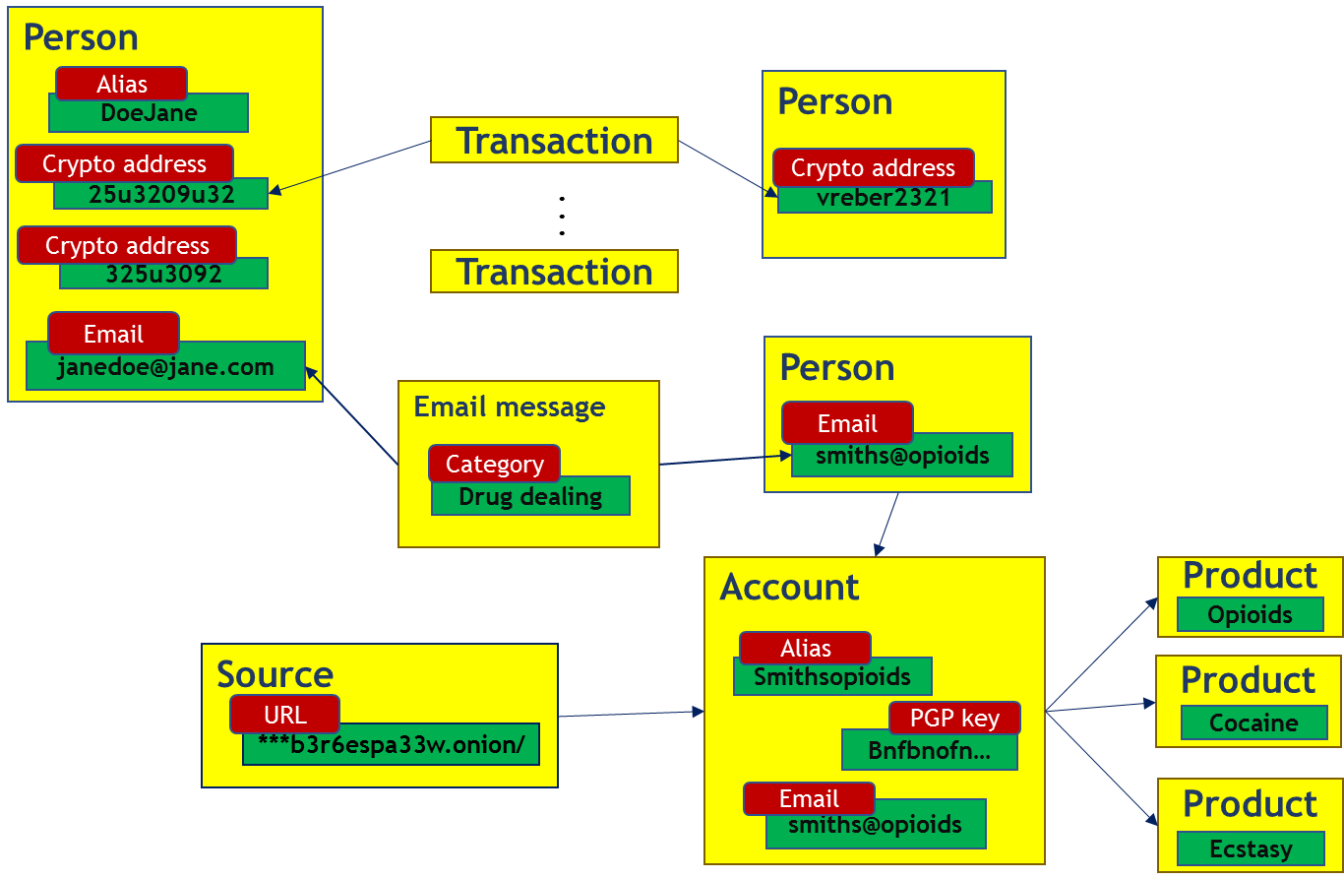
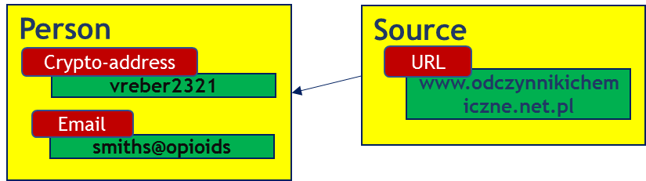
Scenario description (from D4.1)
Semi-legal business that sells NPS
Criminal network reconstruction (T7.3)

Slide 28
Scenario description (from D4.1)
Semi-legal business that sells NPS
Criminal network reconstruction (T7.3)

Slide 29
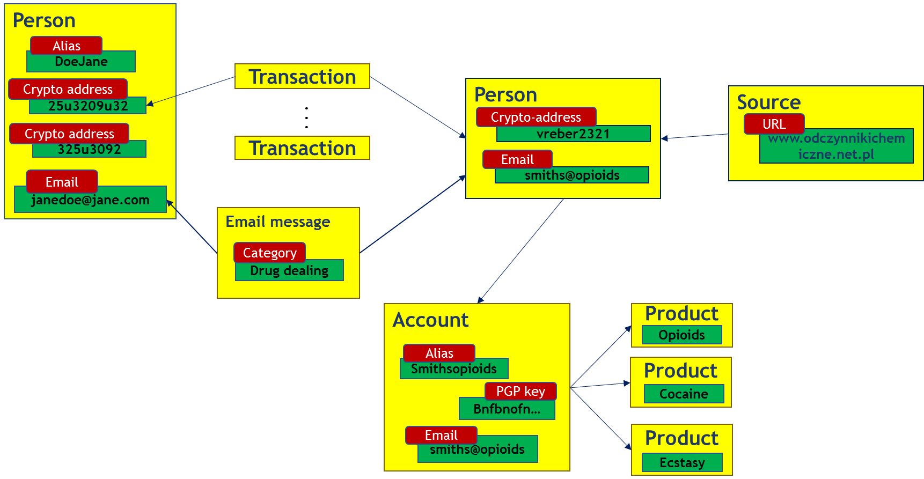
Scenario description (from D4.1)
Semi-legal business that sells NPS
Criminal network reconstruction (T7.3)

Slide 30
Scenario description (from D4.1)
Semi-legal business that sells NPS
Person
Alias
DoeJane
Transaction
Crypto address
Person
Source
25u3209u32
.
.
.
Crypto-address
Crypto address
vreber2321
URL
325u3092
Transaction
www.odczynnikichemiczne.net.pl
Email
Email
smiths@opioids
janedoe@jane.com
Email message
Category
Drug dealing
Account
Product
Opioids
Source
Alias
Product
Smithsopioids
URL
PGP key
Cocaine
***b3r6espa33w.onion/
Bnfbnofn…
Email
Product
smiths@opioids
Ecstasy

Slide 31
Scenario description (from D4.1)
E-mail spam messages
The victims of this criminal act are usually affected by bulk spam e-mail messages, offering medicines to increase sexual performance (Viagra or Cialis) or alternatively, elixirs and ointments that promise treatment in very common diseases. In such cases, the investigation begins when the victims seek help from the police. Α part of the victims occasionally respond to these emails and tries to make contact, influenced either by the beneficial characteristics of the advertised products or by the additional free packages that they promise in every bulk order. In addition, in some cases (e.g. strange elixirs), the deluded buyers are tempted to share the content of the fraud, in their social network, in order to deceive more victims. In this way, even future victims assist in the work of the scammers, as they advertise the products (even if they did not get the ointments/elixirs yet). More and more people are involved in the fraud without anyone suspecting the key crooks. After the initial contact, victims are offered to pay before sending the product, usually through a ‘secure’ card payment process – mimicking services like PayPal, MasterCard, Maestro, American Express or other similar. This process includes: 1. Payment through first and last contact – shipment is paid but it never arrives. 2. Payment is made and shipment information is available on the website of the scammer, luring and tricking the victim (i.e. giving a false sense of certainty) – and when the victim realizes the fraud –it is too late. 3. Payment is made but the transaction details (i.e. credit card information) are stolen and sold on the black market. 4. Payment is made and the victim receives the package, but the content is different from the one ordered (e.g. bricks packed in the package).

Slide 32

Scenario description (from D4.1)
E-mail spam messages
Sender: medicines@doctors.com
Multilingual automated
translation (T6.3)
Multilingual Text analysis (T6.1)
Email message
Email content (Text)
JohnDoe
same address
Image and video analysis (T6.2)
Recipient: john@doe.com
www.2438ty2r30t3.net

Slide 33
Scenario description (from D4.1)
Person-to-person drugs delivery
New ‘jobs’ arise that involve answering the phone, delivering the goods to the buyer, collecting extra supplies as parcels from post lockers when stocks run low. The customers are found as mentioned above, while the prices are predefined and the immigrant keeps the delivery fee as earnings. If the immigrant is arrested, they have not met and do not know the names or faces of those running the operation. Often to ensure the loyalty of the immigrant the criminal gang running the operation keeps their passport or identity papers.

Slide 34
Scenario description (from D4.1)
Drugs delivered to a PO address
Other gangs work without person-to-person delivery, they deliver their products (narcotics) through the local post services to a specific PO Box, but with different recipients. The police have arrested a suspect and identified the owner of the PO Box address. The owner is arrested and during the interview, he admits buying narcotics on a Dark Web site using Bitcoin. Although he is arrested and charged for narcotic offences, further investigation in order to arrest the person that is behind these sales has not been conducted yet. The investigation is complicated, not only by the fact that the offence occurred over two different municipalities of police jurisdiction but also because of the evidence available. The officers might know the transactions that he made in the past in order to buy drugs and they may have access to his social media profiles that he uses, but they cannot detect the money trails.

Slide 35
Scenario description (from D4.1)
Drugs delivered to a PO address
A similar case to the previous one occurred in Belgium. After a routine vehicle stop, the occupants were found to be drug users and during the interview, they provided the address from which they had bought the drugs. Investigation of the address given, shows that observation of the premises would be difficult from both logistical and operational reasons. The location is difficult to observe covertly without being detected and long-term surveillance require extensive permissions from within the judiciary. In Belgium the observation of a person for more than 5 consecutive days or five days in a month requires an added layer of authorisation. This led by necessity to gathering information on the drug dealer from public information on the internet and data held on police databases. After the drug dealer is arrested, the house is searched and it is found that the drug dealer has some knowledge of crypto-currencies, specifically Ethereum. Evidence of crypto-currency transactions are found but it is not possible to trace the destination of the transactions. This information can be extremely important as other evidence discovered during the search show that at least three more dealers are involved.

Slide 36
Next steps
Feedback from LEAs (AoC, NPN, KWPG, GDCOC, LPV) and tech partners no later than 7 December 2018 (slides available on ANITA portal)
ENG will finalize workflow for scenarios “E-mail spam messages”, “Person-to-person drugs delivery” and “Drugs delivered to a PO address”
Inclusion of missing functionalities
Multilingual speech to text (but maybe will be not included in UC1) (T6.4)
Visual indexing (T6.6)
Extraction of evolving knowledge from deep neural network representations (T7.5)
Implicit and explicit user feedback capturing (T8.1)
Adaptive user modelling for cognitive states estimation (T8.2)
Incorporation of conscious and subconscious user feedback in deep learning representations (T8.3)
Knowledge transfer to new officers (T8.4)
To discuss in detail with WP8 partners
and UC leaders because these tasks are transversal

Slide 37
WP4 - Use cases, Requirements and System Architecture
Thank you for your attention

